Slide 1
ANALYSIS OF STREET CHILDREN IN KATSINA CITY METROPOLIS BY
HAJJAH FANNAH SUPPORTIVE AND DEVELOPMENT INITIATIVE
17TH FEBUARY 2016

Slide 2
I am the founder/ CEO of Hajjah Fannah Supportive and Development Initiative Nationwide with particular emphasis in katsina state.
I decided to conduct the research in order to find out the causes of street begging in katsina city metropolis. The causes of street begging among under age children, as to whether they are unite with their family or not, about their family setting, weather the parents are alive or not, weather both parents are still living together or not and to look at their age range and sex. Moreso, most of the women begging on the street are child bearing age mothers. This is specifically what arouse our interest to find out the causes of their street begging in katsina city metropolis.
Fatima Hussaini(FCGDP)
Founder MD&CEO Hajjah Fannah
Supportive &Development Initiative
+2348036266537

Slide 9
SUMMARY OF THE RESEARCH
The total number of the respondants are as follows : male 70, Female 30, between the age of 2 to 35 years.
About their family setting 25 are monogamy and 75 polygamy respectively. Out of the sample of the children taken shows that 70 of them their parents are alive while 30 are orphans . Similarly, 65 of them their parents are living together while 35 are apart .
The total number of children begging in the street as per their range of age is as follows : 2 to 5 Years =20 children, 6 to 10 years =57 children, 11 to 15 years = 15 children, 16 to 19 years =8 children. From the above analysis it clearly shows that children at the age of 16 to 19 reduce in their numbers in street begging and as such they usually disappear in the street and their whereabouts is unknown. This signifies that Almajiri school is the breeding place for criminals in the state.
The total number of marital status of women begging in the street of katsina city metropolis are outlined as follows: for single women =8, for married women=15, for widows =35 and for divorce is =25

Slide 10
RECOMMENDATIONS
The Government should take strict measures in restricting rampant divorce in the community .
Standard religious leaders who are truly religious leaders and have the concern for humanity should be assign to preach on this matter of street begging, most especially religious places.
Community sensitization should be emphasize most especially in rural areas, were divorce is common and mostly affected .
Religious bodies eg HISBA should be revived with dedicated and honest staff that have concern for humanity, where men are under obligation to take good and proper care of their children, during the subsisting of the marriage and after divorce.
Moreso, orphans should be taking care by the relatives of the deceased, as most of them affected are children neglected by their father, hence their mothers cannot take adequate care of them.
School for Almajirai should be formally structured to suit both religion and western education. For instance we offer such idea to one religiuos leader that operate one of the Almajirai school in person of mal musa to conduct both religion and western education , currently he has over 6 graduates and 30 NCE and Diploma holders in various field of endeavor with many of them still in progress.
Government should use research as a tool that will guide the state in tackling any future issues.

Slide 11
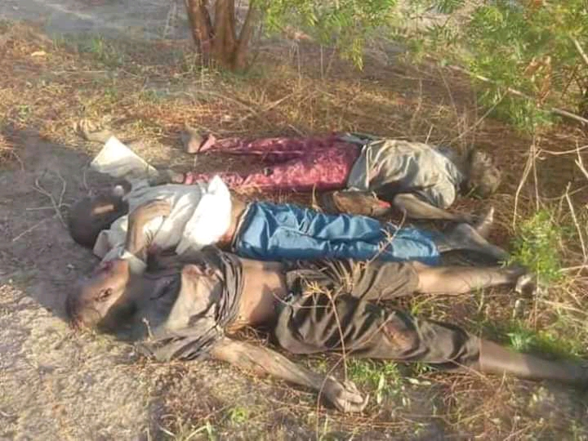
THE PICTURES BELOW SHOWS A CLEAR SITUATION WHERE ALMAJIRIS CHILDREN AT THE AGE OF 16 TO 19 DISSAPEAR IN STREET BEGGING AND ENGAGE THEMSELVES INTO UNLAWFUL ACT
The total number of children begging in the street as per their range of age is as follows : 2 to 5 Years =20 children, 6 to 10 years =57 children, 11 to 15 years = 15 children, 16 to 19 years =8 children. From the above analysis it clearly shows that children at the age of 16 to 19 reduce in their numbers in street begging and as such they usually disappear in the street and their whereabouts is unknown. This signifies that Almajiri school is the breeding place for criminals in the state

Slide 12
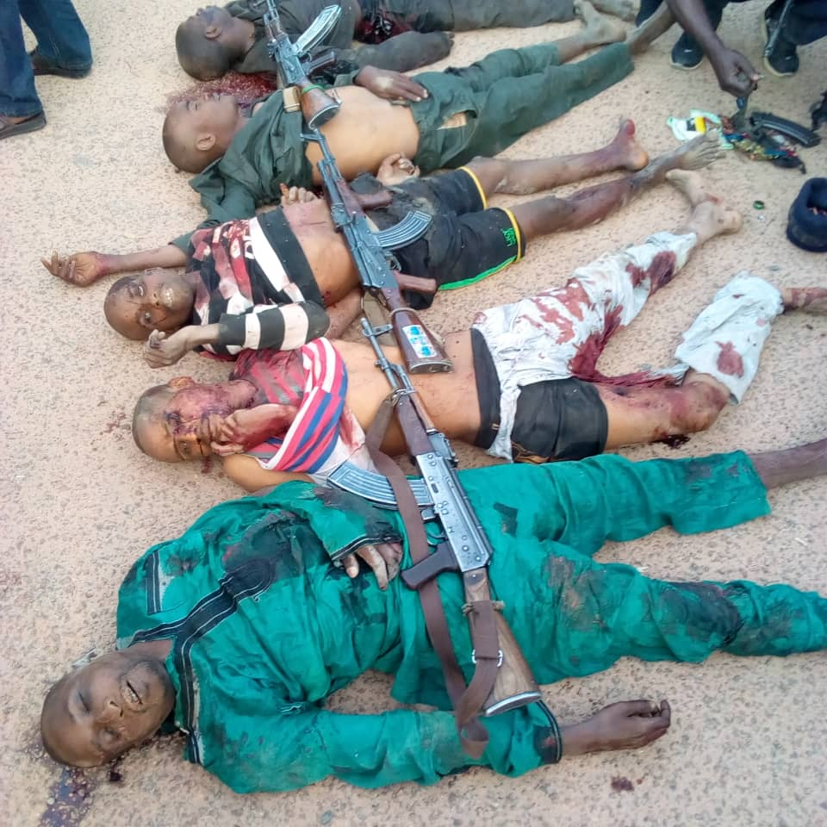

Slide 13
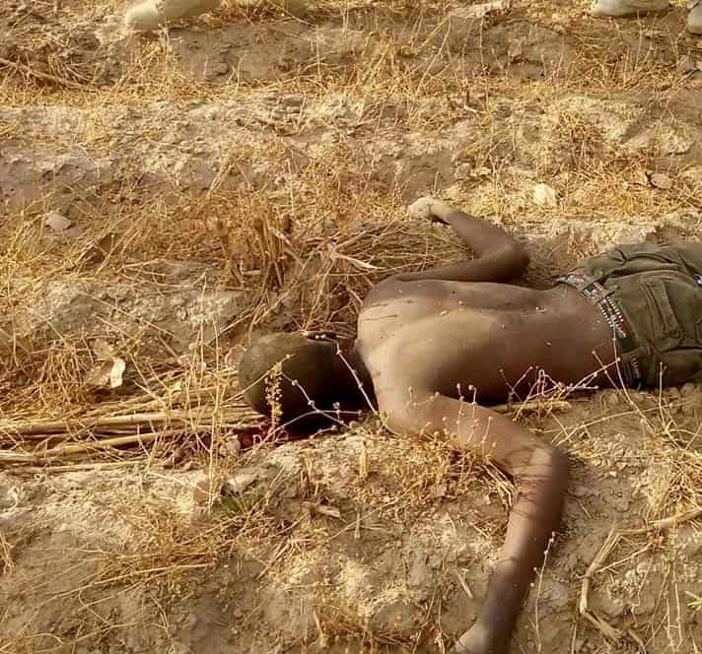

Slide 14
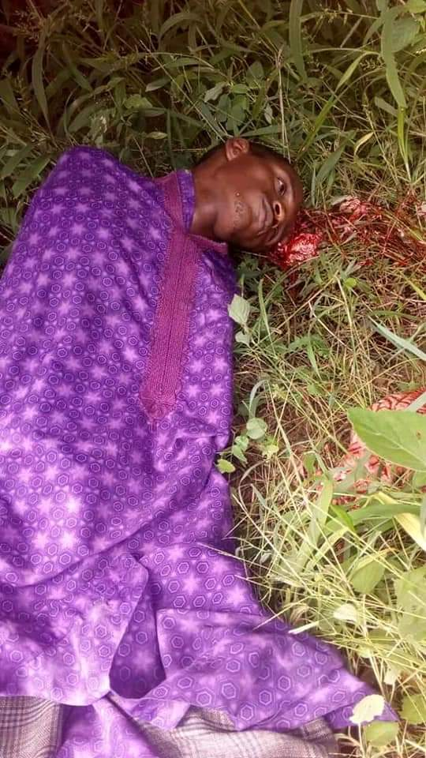

Slide 15
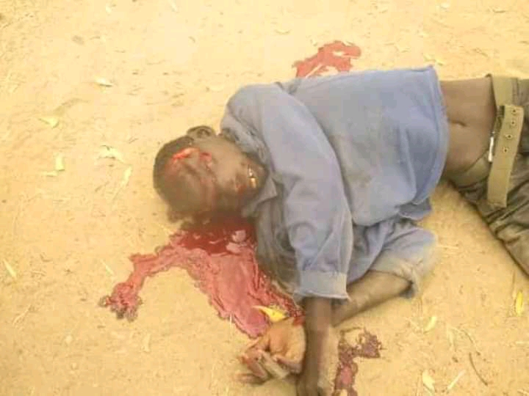

Slide 16
THIS IS THE LINK THAT YOU MAY WISH TO VIEW OUR FUTURE ORGANIZATIONAL PROJECT ON PEACE AND JUSTICE.
https://youtu.be/rT_1xRS4wywh

